Slide 1
FIFA World Cup Analysis by Visualization
Dec
2022
Group 3
Paige Gonzales, Sonal Ganvir & Arkaprava Hajra

Slide 2

Data Sources
Our primary dataset: https://www.kaggle.com/datasets/evangower/fifa-world-cup
We added “Attendance” and “Stadium” from a separate dataset: https://www.kaggle.com/datasets/abecklas/fifa-world-cup?select=WorldCupMatches.csv
Missing values for 2018 were manually entered using Wikipedia: https://en.wikipedia.org/wiki/2018_FIFA_World_Cup
FIFA World Cup Analysis

Slide 3
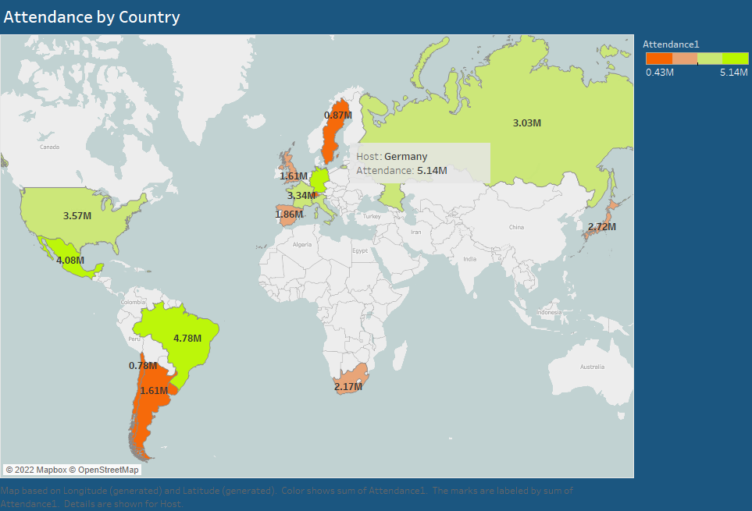
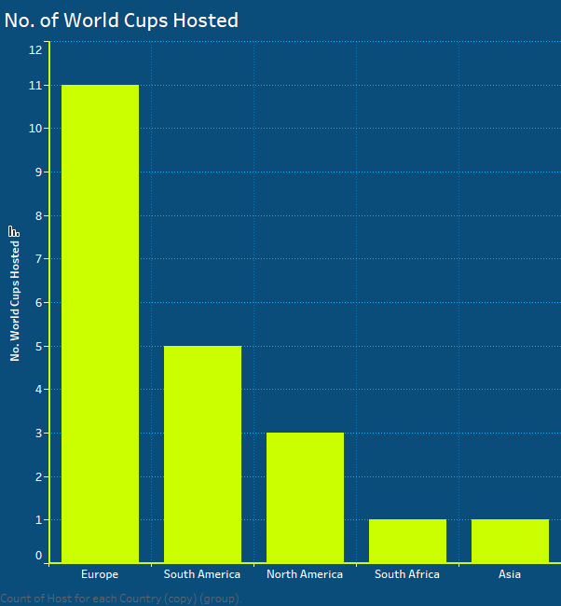
FIFA World Cup Analysis
Notes:
currently being hosted in Qatar for the 22nd edition
occurs every four years with 211 countries competing for a spot
Europe has the most number of World Cups Hosted
England was where the first official match of soccer was played for the first time
By the twentieth century football had gained ground all around the world and national football associations were being founded
The first official international match outside the British Isles was played between Uruguay and Argentina in Montevideo in July 1902.
Est. in 1930
It was by invitation only
13 nations took part in the first World Cup (seven from South America, four from Europe and two from North America.)
Currently 32 teams
Italy, Germany, Mexico, France, and Brazil have hosted twice
Mexico in 2026 will host the most in history
Only four countries in South America and one in Africa and one in Asia

Slide 4
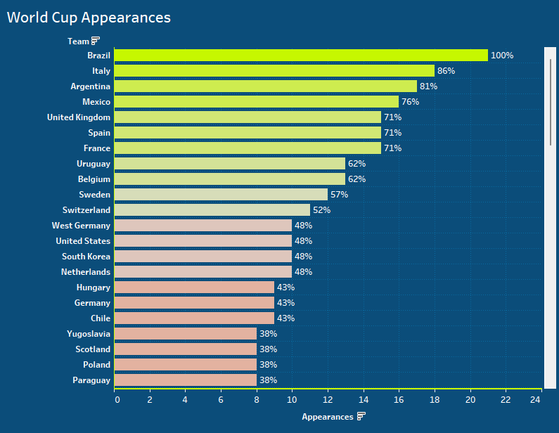
FIFA World Cup Analysis
Notes:
Brazil is the only country that has made it to every world cup in history
Only 11 countries have made it to the World Cup more than half the time
Italy has missed 3 world cups and Argentina missed 4
84 countries have qualified in history

Slide 5
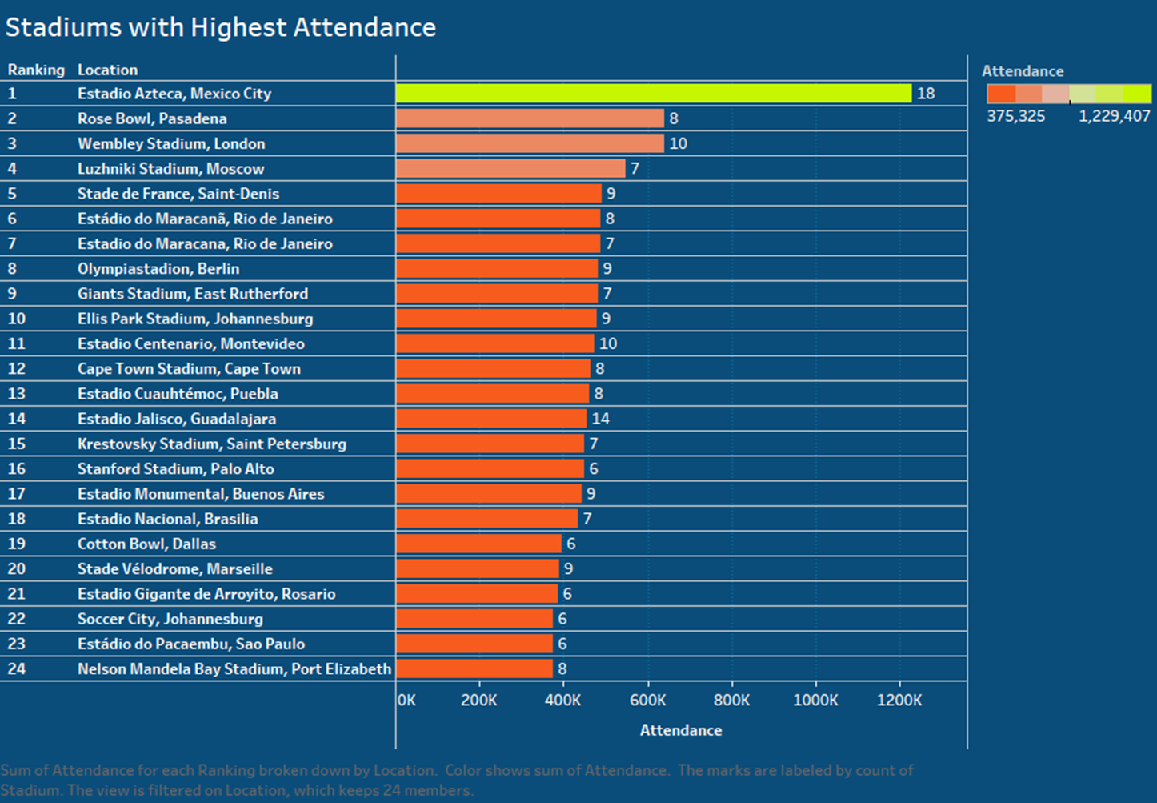
FIFA World Cup Analysis
Notes:
Estadio Azteca - Hosted two world cup finals, 1970 and 1986
Will be hosting again in the North American World Cup in 2026
Largest stadium in Mexico and LATAM and can hold nearly 90,000 people

Slide 6
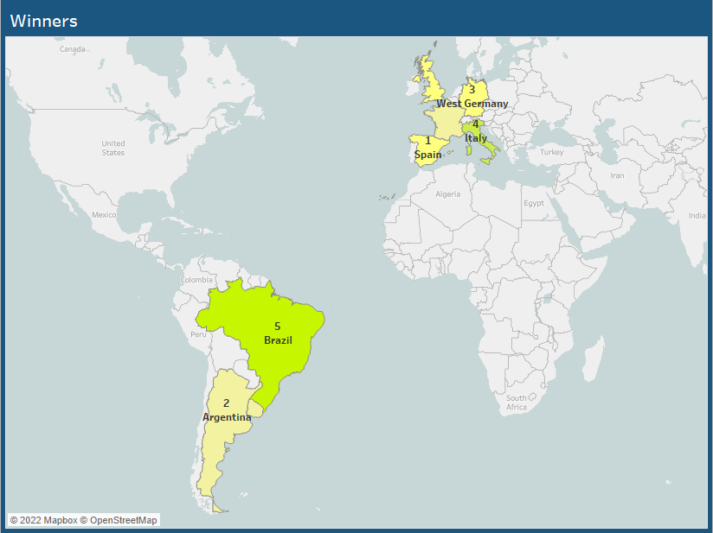
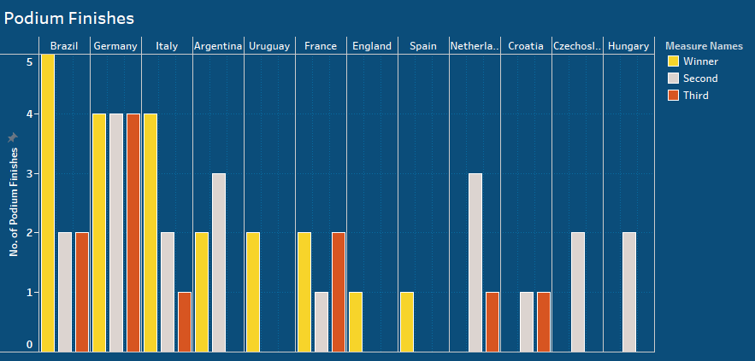
Notes:
We have these two visualizations to talk about the performance of countries at the world cup. The map represents the winners and number of times they have won the World Cup. We see that the winners are mostly concentrated in South America and Western Europe. There have been countries which,albeit not winning the thing,have had podium finishes in terms of being runner up or 3rd place. Netherlands is a big example.
The bar graph comparison shows the winners, second and third place teams in terms of gold,silver and bronze colors. We see that mostly Brazil, Germany and Italy has won gold medals while countries Netherlands and Croatia were able to get the runners up position.

Slide 7
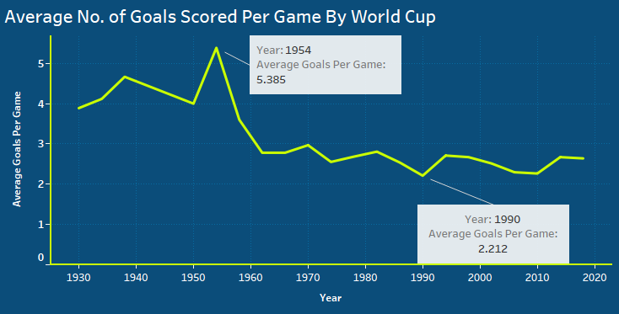
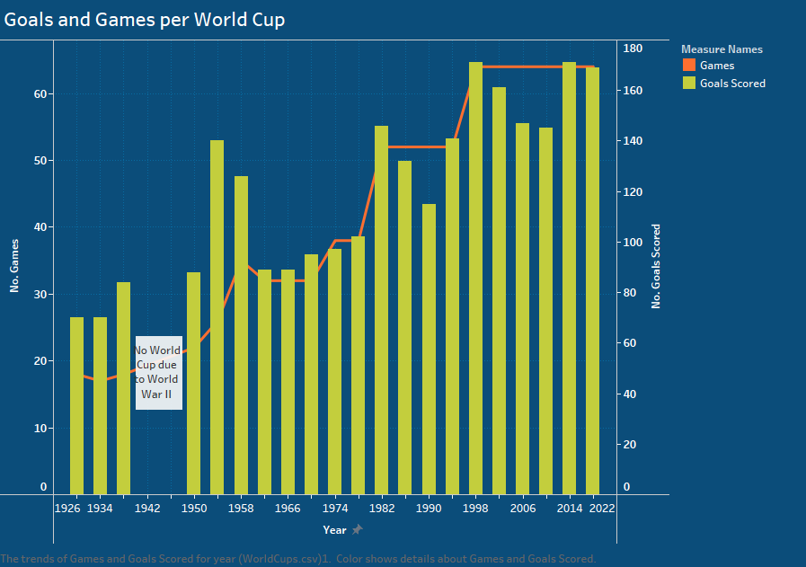
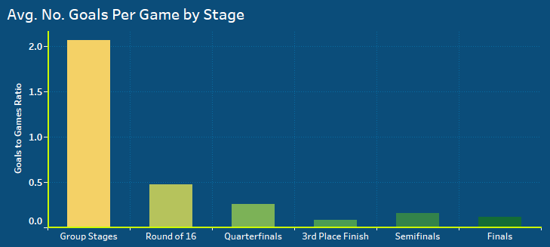
FIFA World Cup Analysis
Notes:
The first graph is a combination of line and bar graph. It talks about the goals scored throughout the World cup history. As the number of teams have increased, the goals have also started to increase.
We see that there is no stats for the year 1942 and 1946 as there was a ongoing World War 2.
The line graph on the right talks about how the goals have dried up with more increased games and teams. This is evident from the decreasing trend of avg. goals scored per game in each world cup. 1954 Switzerland was an exception. At the tournament several all-time records for goal-scoring were set, including the highest average number of goals scored per game
The 1990 World Cup is widely regarded as one of the poorest World Cups in terms of the games.
The last bar graph shows the goals scored through each stage of a World Cup. As evident, goals are more in the group stages as there are more teams.

Slide 8
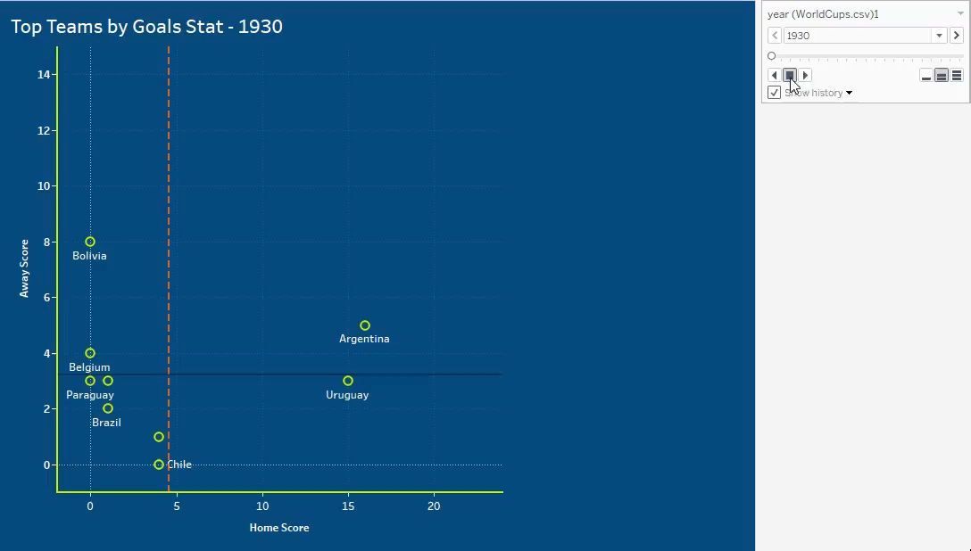
Notes:
We have these two visualizations to talk about the performance of countries at the world cup. The map represents the winners and number of times they have won the World Cup. We see that the winners are mostly concentrated in South America and Western Europe. There have been countries which,albeit not winning the thing,have had podium finishes in terms of being runner up or 3rd place. Netherlands is a big example.
The bar graph comparison shows the winners, second and third place teams in terms of gold,silver and bronze colors.

Slide 9
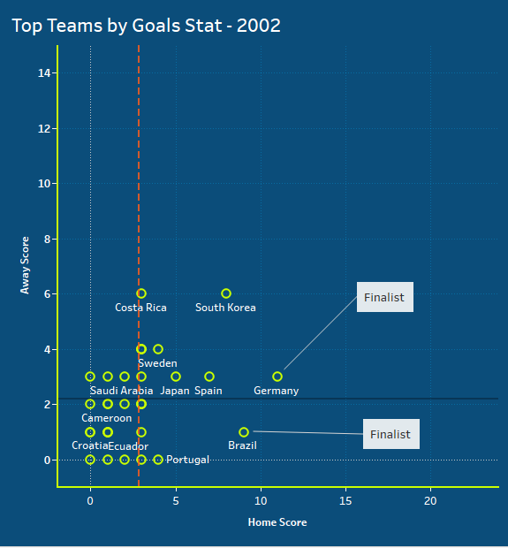
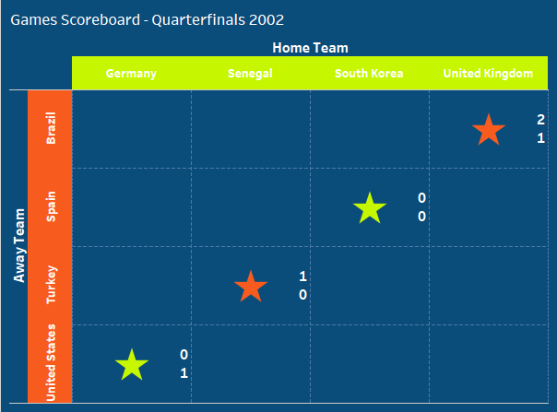
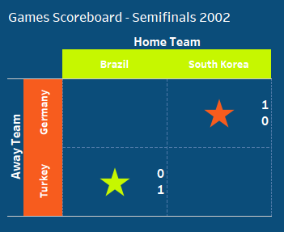
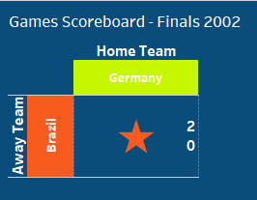
FIFA World Cup Analysis
Notes:
This slide has two different visualizations. The first visualization is a scatterplot matrix . In the Fifa World Cup, each team is allocated as a home and away team. Question may arise why do this at a neutral venue. Delving into a bit of history, the fifa World cup is a global competition which draws a lot of emotions from fans and players as well. Many teams are well known for their colors, like Mexico is Green, France is known for their chants “Allez Les bleus” . This scatterplot matrix shows how each country performed at each WC as a home and away team. In the current screen, we have the fifa wc 2002 where we see South Korea, Germany and Brazil being high performing teams where they scored a lot of goals. Some of the lower ranked nations who where knocked out earlu have the lowest goals on the matrix.
The second visualization is scoreboard visual which represents the results in terms of the winning team’s color. Draws are colored separately.

Slide 10
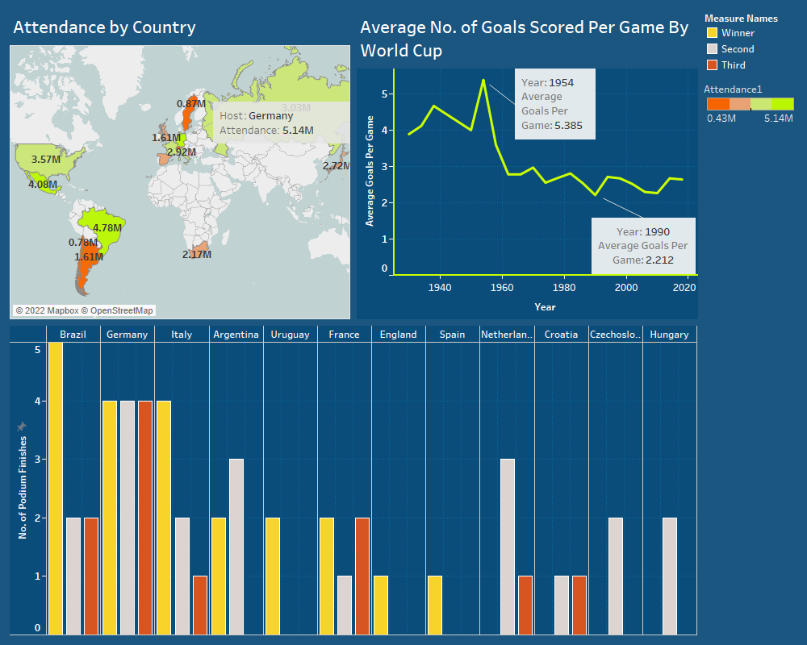
Major World Cup Stats
Dashboard
Notes:
This dashboard is a exploratory/storytelling dashboard which takes some of the key visual statistics from our previous slides and presents it to the final audience. From the dashboard, we can see the host countries, the attendance at those locations, the winners and runners up and how the goals where scored through the tournaments

Slide 11
THANK YOU!
Link to the Presentation:
video1256912896.mp4
FIFA World Cup Analysis

